Slide 1
Applied Statistics, Probability theory and mathematical statistics
István Fazekas, Attila Barta, Sándor Pecsora
statistics, parametric test
”This work was supported by the construction EFOP-3.4.3-16-2016-00021. The project was supported by the European Union, co-financed by the European Social Fund.”

Slide 2

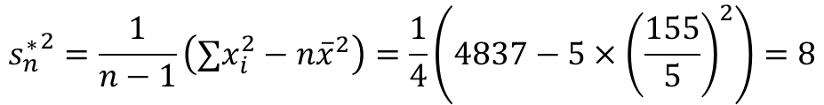
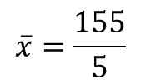

Exercise 16.3
In a random sample of size five the sum of the sample values equals 155, while the sum of their squares equals 4837. Find the mean and the variance of the sample.
$${s_{n}^{∗}}^{2}=\frac{1}{n−1}∑{\left(x_{i}−\overline{x}\right)}^{2}=\frac{1}{n−1}\left(∑{\left(x_{i}−a\right)}^{2}−n{\left(\overline{x}−a\right)}^{2}\right)$$
$$a=0$$
$${s_{n}^{∗}}^{2}=\frac{1}{n−1}\left(∑x_{i}^{2}−n{\overline{x}}^{2}\right)$$
$$\overline{x}=\frac{155}{5}$$
$${s_{n}^{∗}}^{2}=\frac{1}{n−1}\left(∑x_{i}^{2}−n{\overline{x}}^{2}\right)=\frac{1}{4}\left(4837−5×{\left(\frac{155}{5}\right)}^{2}\right)=8$$

Slide 3






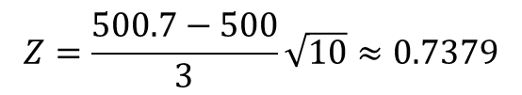





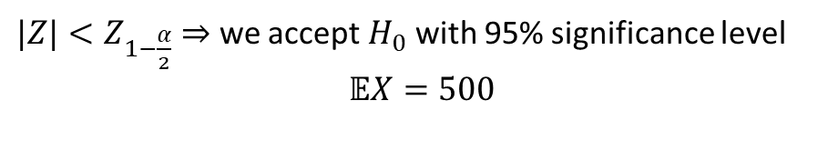
Exercise 16.4 (M1)
The volumes, in mililitres, of soft drink of a random sample of 10 bottles from a large batch were as follows:
499, 525, 498, 503, 501, 497, 493, 496, 500, 495.
Stating clearly your null and alternative hypotheses, test the claim that the mean volume of soft drink in bottles in the batch is 500 ml. Use a 95% confidence level. Assume that, for the batch, volumes are normally distributed with a standard deviationof 3 ml.
$$Z−test, since σ is given$$
$$Significance level:95\%$$
$$σ=3$$
$$\overline{x}=500.7$$
$$α=0.05$$
$\frac{α}{2}=0.0$25
$$Z=\frac{\overline{x}−m_{0}}{σ}\sqrt{n}\sim 𝒩\left(0,1\right)$$
$$Φ\left(Z_{1−\frac{α}{2}}\right)=0.975$$
$$⇒$$
$$Z_{1−\frac{α}{2}}=1.96$$
$$H_{0}:𝔼X=500=m_{0} \\ H_{1}:𝔼X≠500$$
$|Z|<Z_{1−\frac{α}{2}}⇒$ we accept $H_{0}$ with 95% significance level
$$𝔼X=500$$
$$Z=\frac{500.7−500}{3}\sqrt{10}≈0.7379$$

Slide 4
Exercise 16.4 (M1)
data=[499 525 498 503 501 497 493 496 500 495];
[h,p] = ztest(data,500,3,'Alpha',0.05,'Tail','both')
alpha = 0.05;
x=-3:0.01:3;
plot(x,normpdf(x))
hold on
z_alpha_2 = norminv(1-alpha/2);
area(-z_alpha_2:0.01:z_alpha_2,normpdf(-z_alpha_2:0.01:z_alpha_2),'FaceColor','g')
hold off

Slide 5
Exercise 16.8 (M2)
Experiments with a new variety of tomato are being conducted at an agricultural research station. The crop is grown under carefully controlled conditions on ten experimental plots and the yields, in kg per plot, are found to be as follows:
60.2, 63.4, 58.8, 63.6, 64.7, 62.5, 66.0, 59.1, 65.1, 62.0;
It is known that an established variety of tomato would have a mean yield of 60 kg per plot on the experimental plot. Test, at the 95% level of significance, whether the new variety has a different mean yield, stating clearly your null and alternative hypotheses. State also the assumptions underlying your analysis.

Slide 6







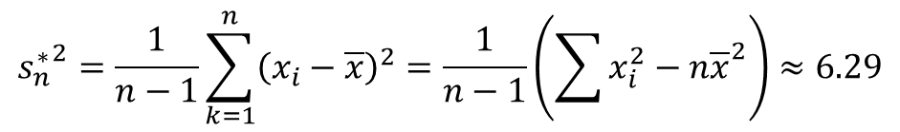

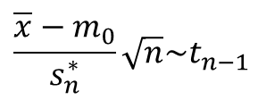

Exercise 16.8
$$\overline{x}=62.54$$
$$H_{0}:𝔼X=60=m_{0} \\ H_{1}:𝔼X≠60$$
$$\frac{\overline{x}−m_{0}}{s_{n}^{∗}}\sqrt{n}\sim t_{n−1}$$
$${s_{n}^{∗}}^{2}=\frac{1}{n−1}\sum_{k=1}^{n}{{\left(x_{i}−\overline{x}\right)}^{2}}=\frac{1}{n−1}\left(\sum{x_{i}^{2}−n{\overline{x}}^{2}}\right)≈6.29$$
$$s_{n}^{∗}≈2.51$$
$$t=\frac{62.54−60}{2.51}\sqrt{10}≈3.2$$
$$α=0.05$$
$\frac{α}{2}=0.0$25
$$t_{1−\frac{α}{2}}=2.2622$$
$$\left|t\right|>t_{1−\frac{α}{2}}$$
$⇒$ we reject $H_{0}$

Slide 7
Exercise 16.8 (M2)
data=[60.2, 63.4, 58.8, 63.6, 64.7, 62.5, 66.0, 59.1, 65.1, 62.0];
[h,p] = ttest(data,60,'Alpha',0.05,'Tail','both')
df = 9;
alpha = 0.05;
x=-3.3:0.01:3.3;
axis([-3.3 3.3 0 0.5])
hold on
plot(x,tpdf(x,df))
t_alpha_2 = tinv(1-alpha/2, df);
area(-t_alpha_2:0.01:t_alpha_2,tpdf(-t_alpha_2:0.01:t_alpha_2,df),'FaceColor','g')
hold off

Slide 8
Exam
load examgrades
x = grades(:,1);
%%%% Test the null hypothesis that the data comes from a normal distribution with mean m = 65 and standard deviation sigma = 10, against the alternative that the mean is greater than 65.
[h,p] = ztest(x,65,10,'Tail','right')

Slide 9
Stock
load stockreturns
x = stocks(:,3);
%%%% Test the null hypothesis that the sample data are from a population with mean equal to zero at the 1% significance level.
[h,p,ci,stats] = ttest(x,0,'Alpha',0.01)

Slide 10
Patient
load patients
tabulate(Gender)
histogram(Height,10) %%% nbins = 10
mean(Height)
std(Height)
quantile(Weight,[0.025 0.25 0.50 0.75 0.975])

Slide 11
Literature
Ágnes Baran: Mathematics for engineers 1. (Laboratory slides)
Sándor Baran: Probability theory and statistics
Fazekas István: Valószínűségszámítás, Debreceni Egyetemi Kiadó, 2009
Fazekas István: Bevezetés a matematikai statisztikába, Debreceni Egyetemi Kiadó, 2009
Matlab examples: https://www.mathworks.com/help/examples.html

